Slide 1
Chapter 12
Writing and Presenting an Offer
After reading this chapter, you will be able to:
define deposit receipts.
describe the main clauses in the deposit receipt.
identify the important information a salesperson should gather prior to filling out the offer to purchase.
list the items a salesperson should bring when presenting an offer.
explain why a salesperson should present an offer in person.
discuss how a salesperson can effectively handle counteroffers.

Slide 2
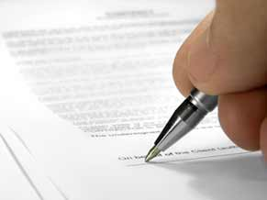
Writing the Offer
Purchase Price and Initial Deposit
Finance Terms
Common Contingencies
Escrow
Early Move-In
Expiration of Offer
Sign the Contract

Slide 3
Purchase Price and Initial Deposit
Purchase Price
    Use the CMA statistics as a guide for setting the amount of the offer with the buyer’s
  Questions to ask buyers before writing the offer
    What is the most the buyers will pay?
    Which is more important to the buyers— price or terms?
    Are the buyers prepared for a counteroffer from the sellers?
    Are there any buyers’ contingencies that must be part of the transaction?
    Is there a critical timeframe for the buyers to close the transaction?
Initial Deposit
    Earnest Money deposit (consideration)
Consideration is a buyers’ deposit in the form of cash, a personal check, cashier’s check, promissory note, money order, or other form usually for 1-3% of the purchase price of the property

Slide 4
Finance Terms
Ask the buyers if they plan to pay all cash, obtain financing, assume a loan, or take title “subject to” an existing loan.
    If the buyers want to assume the loan, ask if it contains acceleration clauses or prepayment penalties, and have the buyers approved the terms?
    Buyers who submit an all-cash offer have greater negotiating power because all-cash buyers are more financially qualified than those buyers who must obtain financing.
    The all-cash buyers are also in a fortunate position in terms of avoiding mortgage interest and other associated costs involved in obtaining financing, however they lose many of the tax advantages available to homeowners with conventional loans.
All cash transactions close very quickly because the buyers do not have to complete the loan qualification process.

Slide 5
Common Contingencies
Financing Contingency
Title to Property and Its Use
Condition of Property
    Transfer Disclosure Statement (TDS)
    Home Inspections
    Pest Inspections
Contingent on the Sale of Another Home

Slide 6
Escrow
Discuss with your buyers the numerous charges and fees that are inherent in any real estate transaction.
  Who will pay for the title policy, escrow services, and other customary charges?
    Proration
      Proration is the process of distributing or dividing the expenses or income between the sellers and the buyers usually up to the date of closing or the date of possession.
The most common items that are prorated include real property taxes, interest on loans, insurance premiums, rent or assessments, and sewer charges.

Slide 7

Early Move-In
An early move-in allows the buyers to take possession of the property prior to the close of escrow.
A written early occupancy agreement (Interim Occupancy Agreement—Form IOA) should be completed and signed by the sellers (as landlord), the buyers (as tenant), the listing agent (representing the sellers) and the selling agent (representing the buyers).

Slide 8
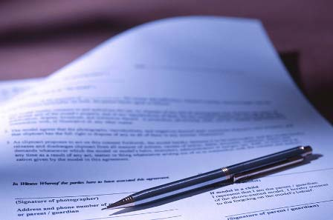
Expiration of Offer
Discuss with your buyers how much time they will allow the sellers to consider the buyers’ offer to purchase.

Slide 9
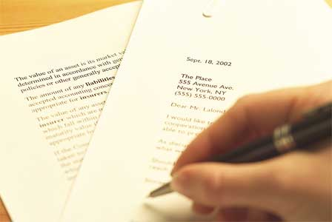
Sign the Contract
Be sure the signatures of all buyers, sellers, and salespeople are on the contract.
Every purchase contract prepared or signed by a real estate salesperson must be reviewed, initialed, and dated by the salesperson’s broker within five working days after preparation or signing by the salesperson, or before the close of escrow, whichever occurs first.
Remember that the offer is not a contract until the broker accepts it.

Slide 10

Presenting the Offer
Prepare for Presentation
    After you have filled out the offer, call the listing salesperson to arrange a presentation.
    The presentation of the offer should be a face-to-face meeting with you, the sellers, and the listing salesperson.

Slide 11
Presenting the Offer
The Presentation
    Arrive on time
    Establish rapport with the sellers
    Talk about the buyers in a way the sellers can relate
    Present the offer and highlight the benefits
    Remain calm and sensitive to the sellers feelings
    After presenting the terms of the offer, ask the sellers and the listing salesperson to review the points you have made and ask for approval.
    Remain silent while they consider the offer.

Slide 12
Counteroffers: Counseling the Sellers
Remind the seller to consider the following:
  The counteroffer supersedes any previous offers made by the buyers
  When you present the counteroffer it becomes the buyers option to accept, reject, or counter.
  The buyers could decide to target another property, especially if the offer was fair and they presented evidence of strong financial backing.
  The buyers have had time to think about aspects of the purchase with which they are uncomfortable such as the monthly payments. Buyers remorse is known as the deal killer.
All counteroffers must be in writing.
When drawing up a counteroffer, avoid making any changes to the purchase contract and use a different form such as C.A.R.® Form CO to ensure clarity.

Slide 13
Counteroffers: Counseling the Buyers
When presenting the sellers’ counteroffer, remember to review the following with your buyers:
    The sellers’ concessions
    The buyers’ motivation
    The benefits of home ownership to the buyers
    How the counteroffer will affect the monthly payments, length of escrow, etc.
    The CMA to show average sales prices
    The additional monies that may be needed
At this point, the buyers may accept the sellers’ counteroffer, completely reject the counteroffer, or submit yet another counteroffer.

Slide 14
Accepting the Counteroffer
The accepting party must notify the offeror of acceptance so that the offer or counteroffer will be valid.
Up until the point of notification of the sellers’ acceptance, the buyers are free to withdraw the offer.
If possible, personally deliver the acceptance to the offeror.
If you mail or fax the acceptance, proof of mailing or a confirmed fax transmittal report should be kept on file.

Slide 15
After Acceptance
Once the sellers agree to the offer and the buyers are informed of the sellers’ acceptance, the deposit receipt is a valid, non-rescindable, binding contract.
Once all parties execute, or sign, the deposit receipt, it becomes a bilateral contract.
your buyers need to order a home inspection to evaluate the mechanical and structural dependability of the home.
The buyers also complete financing arrangements for the loan during this time.
Once all required documents have been signed the listing or selling salesperson must take the paperwork to the chosen escrow company.
A bilateral contract is an agreement in which each person promises to perform an act in exchange for another person’s promise to perform.

