Slide 1
Chapter 14
From Acceptance to Close
Opening Escrow
Who Does What During Escrow?

Slide 2
Learning Objectives
After reading this chapter, you will be able to:
describe the basic requirements for a valid escrow.
discuss the role escrow instructions play in a real estate transaction.
describe what each party involved in a real estate transaction does during escrow.
explain the significance of the preliminary title report.
name three reports an escrow holder accepts during the escrow period.
explain how common real estate contingencies affect buyers and sellers.
list the common closing costs involved in escrow.

Slide 3

Opening Escrow
What is Necessary for a Valid Escrow?
A binding purchase agreement contract made between the parties
Conditional delivery of funds
Conditional delivery of transfer documents

Slide 4

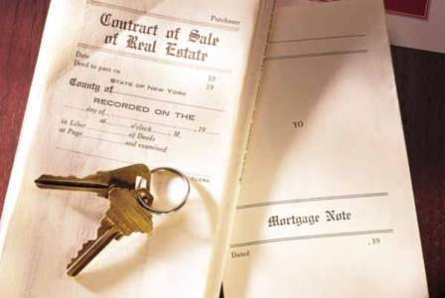
Who Does What During Escrow?
Escrow Holder
Seller
Buyer
Lender

Slide 5
Escrow Holder
Prepares Escrow Instructions
Orders a Title Search
    Preliminary Title Report
    Title Insurance Policy
Receives and Holds All Funds
    Seller’s Loans
    Buyer’s New Loan Instructions and Documents
Accepts Documents and Inspection Reports
Prorates and Allocates Costs
Prepares and Records Deeds
Prepares Final Closing Statements
    Sellers’ Statement
    Buyer’s Statement
Closes Escrow

Slide 6
Seller
Read escrow instructions carefully before signing it.
Sign the Grant Deed before a notary public
Complete any repairs, and any contingencies of the contracts.
Provide the latest Property tax bill, homeowner’s assessment, and mortgage statement.
Escrow information on outstanding liens, judgments, security liens, or loans to be paid off through escrow.
Must provide an inventory sheet for any personal property outside of escrow.

Slide 7
Buyer
Arranges for Financing – deposit sufficient funds to cover escrow and closing costs.
  Property Condition
    Buyers have a set number of days to approve or disapprove all required inspections.
  Title
    Buyers must go over the preliminary title report for any unusual easements, taxes, or anything that will affect the property.
  Review Closing Statement
    Summary of estimated closing costs
  Walk-Through
    Check to make sure that any required work has been completed.
    Check for any undisclosed items that might affect the property’s use which county records would not disclose.
  Possession
    Have the buyers set up accounts for utilities for the new property and close existing ones for their current home.
    Inform the new homeowners how and when to get the keys so they can take possession of their new home.
    Allow the sellers a day or two after closing to move out of the home.

Slide 8
Lender
The lender orders all employment, income, and deposit, verifications.
Orders an appraisal
Orders a credit report
Prepares the loan for underwriting.
If approved:
  the loan is underwritten
  Funds are wired to the escrow or title company

