Slide 1
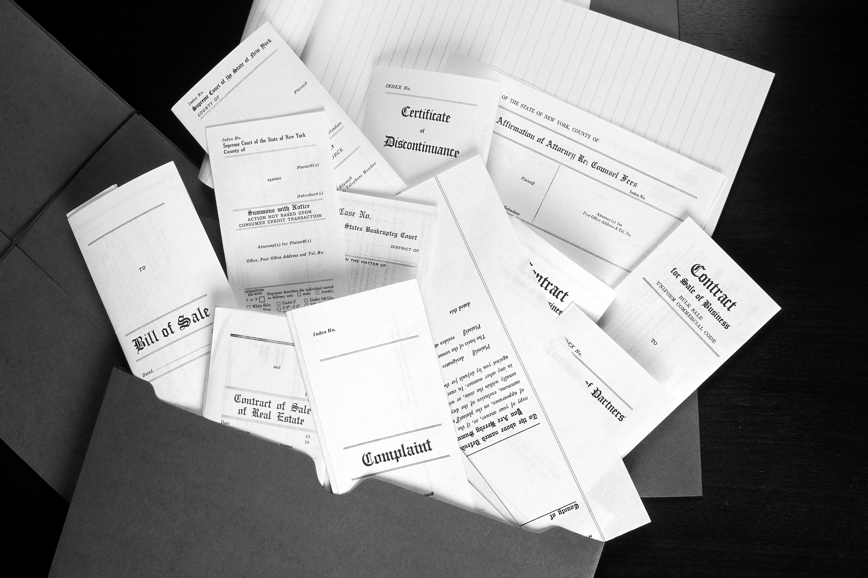
Contracts: The Basics
Chapter 4

Slide 2
CONTRACTS
LEARNING OBJECTIVES
define contract
discuss legal requirements for an enforceable contract
describe performance of contracts and give examples
explain Statute of Frauds
identify remedies for breach of contract

Slide 3
CONTRACTS
legally enforceable agreement made by competent parties, to perform or not perform a certain act
express contract
parties declare the terms and put their intentions in words, either oral or written
implied contract
agreement is shown by act and conduct rather than words

Slide 4
CONTRACTS
executory contract
something remains to be performed by one or both parties
executed contract
all parties have performed completely

Slide 5
CONTRACTS
bilateral contract
agreement in which each person promises to perform an act in exchange for another person’s promise to perform
unilateral contract
contract where a party promises to perform without expectation of performance by the other party
An option is an example of a unilateral contract

Slide 6
CONTRACTS
Void contract
Voidable contract
Unenforceable contract
Valid contract
no contract at all or no legal effect
valid & enforceable but may be rejected by any party
valid, but cannot be proved by one or both of the parties
binding & enforceable, has all the basic elements

Slide 7

CONTRACTS
Basic Elements of All Contracts
legally competent parties
mutual consent between the parties
lawful objective
sufficient consideration

Slide 8
CONTRACTS
Legally Competent Parties
must be at least 18 unless married, in the military or court declared emancipated
contracts with minors are voidable by the minor
minors & incompetents may acquire title by gift or inheritance but transfers must be court approved

Slide 9
CONTRACTS
Legally Competent Parties
contracts made by a person who is under the influence can be cancelled when the individual sobers up
contract may be ratified (approved after the fact) depending on the parties
Any person may give another authority to act on his behalf (power of attorney)

Slide 10
CONTRACTS
Legally Competent Parties
When dealing with real property, a power of attorney must be recorded to be valid
A power of attorney can be cancelled by the principal at any time by recording a revocation
Useful when a buyer or seller is out of town and has full trust in that agent

Slide 11
CONTRACTS
Mutual Consent
offer by one party & acceptance by the other
The offer must be definite and certain in its terms, & agreement genuine or contract may be voidable by either party
acceptance is an unqualified agreement to the terms of an offer
counteroffer becomes a new offer

Slide 12
CONTRACTS
Mutual Consent
Termination
  lapse of time
  communication of notice of revocation
  failure of offeree to fulfill a condition of acceptance
  a qualified acceptance, or counteroffer
  rejection by the offeree
  death or insanity of the offeror or offeree
  unlawful object of the proposed contract

Slide 13
CONTRACTS
Mutual Consent
Genuine Assent
does not exist if there is Fraud
Misrepresentation
Mistake
Duress
Menace
Undue Influence

Slide 14
CONTRACTS
Lawful Object
Contracts requiring performance of an illegal act would not be valid, nor would one with stolen consideration
Must also be legal in its formation and operation
Contracts contrary to good morals and general public policy - unenforceable

Slide 15
CONTRACTS
Sufficient Consideration
something of value
Promise of Future Payment
Money
Property
Personal Services
● valuable ● adequate ● good ● sufficient ●

Slide 16

CONTRACTS
Sufficient Consideration
Includes:
Forbearance (forgiving a debt or obligation)
Giving up an interest or a right
Gifts
real property based solely on love and affection
In bilateral contracts, a promise of one party is consideration for the promise of another

Slide 17

CONTRACTS
Contracts That Must Be In Writing
● offers ● acceptances ●
● loan assumptions ●
● land contracts ●
● deeds ● escrows ●
● options to purchase ●
● trust deeds ●
● promissory notes ●
● leases (1 yr +) ●

Slide 18
CONTRACTS
Parol Evidence Rule
When two parties make oral promises to each other, then write and sign a contract promising something different, the written contract will be considered the valid one
Although the Statute of Frauds does not
require it, all contracts should be in writing

Slide 19
CONTRACTS
Preprinted Forms
Generally, when using preprinted forms:
specific information takes precedence over general information.
typed clauses and insertions take precedence over the pre-printed material
handwritten clauses and insertions take precedence over the typed and pre-printed material

Slide 20


CONTRACTS
Many real estate forms are now electronic and can be downloaded

Slide 21
CONTRACTS
Discharge
cancellation or termination of contract
Performance
Release
Rescission
Assignment
Novation
Breach

Slide 22
CONTRACTS
Discharge
Performance
A tender of performance is an offer by one of the parties to carry out his or her part of the contract
A waiver is the relinquishment or refusal to accept a right
The buyer could rescind the transaction, or sue for breach of contract or for specific performance

Slide 23
CONTRACTS
Discharge
Release
The person in the contract to whom an obligation is owed may release the other party from the obligation to perform the contract
Mutual Rescission
A mutual rescission occurs when all parties to a contract agree to cancel the agreement

Slide 24
CONTRACTS
Discharge
Assignment
transfers all the interests of the assignor to assignee who takes over the assignor’s rights, remedies, benefits and duties in the contract
assignor not completely released from obligations
٭ remains secondarily liable ٭

Slide 25
CONTRACTS
Discharge
Novation
A substitution of a new obligation for an existing one, with the intent to extinguish the original
٭occurs when a buyer assumes a seller’s loan ٭

Slide 26
CONTRACTS
Discharge
Breach
failure to perform on part or all of the terms and conditions of a contract
Three Remedies for Breach of Contract
1. Unilateral Rescission
2. Lawsuit for money damages
3. Lawsuit for specific performance

Slide 27
CONTRACTS
Discharge
Breach
• Unilateral Rescission
• Lawsuit for money damages
• Lawsuit for specific performance
remedy for a person who enters a contract without genuine assent because of fraud, mistake, duress, menace, undue influence or faulty consideration

Slide 28
CONTRACTS
Discharge
Breach
• Unilateral Rescission
• Lawsuit for money damages
• Lawsuit for specific performance
innocent party can sue for damages to include: price paid by buyer, difference between contract price and property value, title and document expenses, consequential damages and interest

Slide 29
CONTRACTS
Discharge
Breach
• Unilateral Rescission
• Lawsuit for money damages
• Lawsuit for specific performance
Court action to force breaching party to carry out remainder of contract
Often the case in real estate because of the difficulty in finding a similar property

Slide 30
CONTRACTS
Statute of Limitations
Under California law, any person seeking relief for a breach of contract must do so within the guidelines of the Statute of Limitations

Slide 31
CONTRACTS
Statute of Limitations
90 Days
Civil actions to recover personal property such as suitcases, clothing or jewelry alleged to have been left at a hotel or in an apartment must begin within 90 days after owners depart from the property

Slide 32
CONTRACTS
Statute of Limitations
6 Months
Action against an officer to recover property seized in an official capacity
such as by a tax collector

Slide 33
CONTRACTS
Statute of Limitations
1 Year
Libel or slander, injury or death caused by wrongful act, or loss to depositor against a bank for the payment of a forged check

Slide 34
CONTRACTS
Statute of Limitations
2 Years
Action on a contract, not in writing; action based on a policy of title insurance

Slide 35
CONTRACTS
Statute of Limitations
3 Years
Action on a liability created by statute
Action for trespass on or injury to real property, such as encroachment
Action for relief on the grounds of fraud or mistake
Attachment

Slide 36
CONTRACTS
Statute of Limitations
4 Years
Action on any written contract
(includes most real estate contracts)

Slide 37
CONTRACTS
Statute of Limitations
10 Years
Action on a judgment or decree of any court in the United States

Slide 38
CONTRACTS
This concludes the
presentation on
the basics of contracts

